Slide 1
HireAC
YOUR HOW TO GUIDE

Slide 2
HireAC Guide Sections
Getting Started with HireAC
Cooperative Education Module in HireAC
Changing Preferred Name in HireAC
Downloading the Co-op Work Permit Confirmation Letter
Co-op Documents Page in HireAC
Co-op Job Postings Page in HireAC
Setting up Job Alerts in HireAC
Co-op Interviews Page in HireAC
Co-op Job Offers in HireAC
Co-op Work-term record in HireAC
Booking a Peer Review meeting in HireAC
Events And Workshops Module in HireAC
Career & Employment Module in HireAC

Slide 3
3. Changing Preferred Name in HireAC
Process details and steps

Slide 4
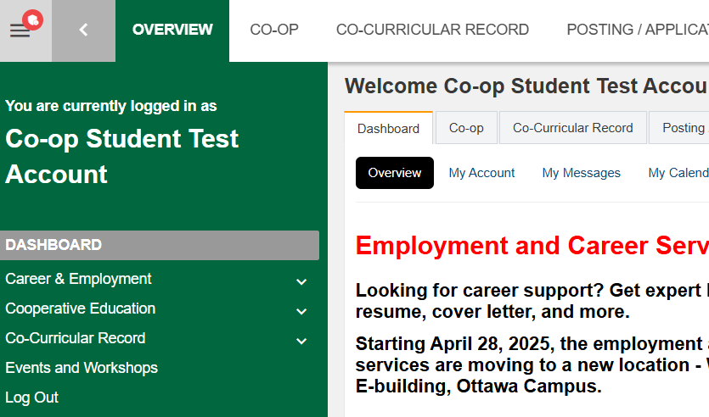
Changing Preferred Name in HireAC
HireAC account information is pulled from the student information system, ACSIS. The name that is visible in HireAC is your legal name. However, if you have a preferred name, please follow these steps to ensure your HireAC account is accurate.
Log in to HireAC
Select “My Account”
Check the box next to “Use Preferred Name across the site”
Scroll down to the bottom of the page and click “Save”
Once saved, a pop-up message will say “Success – Changes Successfully Saved and Account Updated”

